Slide 1
GRAFAI. DFS (Depth First Search) taikymai) Doc. E.Mačikėnas

Slide 2
GRAFAI. DFS terminija
Graph traverse – grafo apėjimas
To keep track of progress depth-first-search colors each vertex. Each vertex of the graph is in one of three states (colors):
1. Undiscovered (naujos viršūnės); 2. Discovered but not finished (not done exploring from it) (aplankytos viršūnės); 3. Finished (have found everything reachable from it) i.e. fully explored (išnaudotos viršūnės).
Note that the edges lead to new vertices are called discovery or tree edges and the edges lead to already visited (painted) vertices are called back edges.

Slide 3
GRAFAI. DFS taikymai
Depth-first search is a systematic way to find all the vertices reachable from a source vertex, s. Historically, depth-first was first stated formally hundreds of years ago as a method for traversing mazes. Like breadth-first search, DFS traverse a connected component of a given graph and defines a spanning tree.
(spanning tree – dengiantysis medis)

Slide 4
GRAFAI. DFS taikymai
Computing a path between two vertices of G or reporting that no such path exists.
Path Finding - We can specialize the DFS algorithm to find a path between two given vertices u and z.
i) Call DFS(G, U) with u as the start vertex. ii) Use a stack S to keep track of the path between
the start vertex and the current vertex. iii) As soon as destination vertex z is encountered,
return the path as the contents of the stack.

Slide 5
GRAFAI. DFS taikymai
Algorithms based on DFS
Based upon DFS, there are algorithms used for the following problems:
Testing whether graph is connected.
Computing a spanning forest of G.
Computing the connected components of G.
Computing a path between two vertices of G or reporting that no such path exists.
Computing a cycle in G or reporting that no such cycle exists.

Slide 6
GRAFAI. DFS taikymai
Kitas šaltinis:
http://www.geeksforgeeks.org/archives/11644

Slide 7
GRAFAI. DFS taikymai
Following are the problems that use DFS as a bulding block.
1) For an unweighted graph, DFS traversal of the graph produces the minimum spanning tree.
2) Detecting cycle in a graph. 3) Path Finding.
4) Topological Sorting. 5) To test if a graph is bipartite.
6) Finding Strongly Connected Components of a graph. 7) Solving puzzles with only one solution, such as mazes.

Slide 8
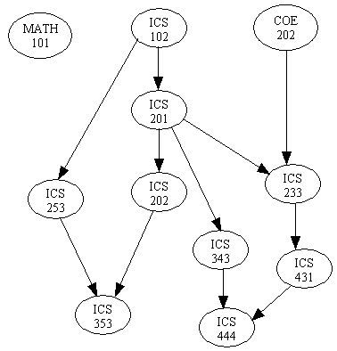
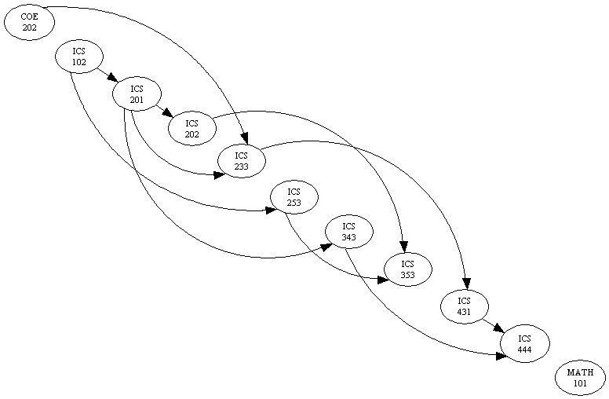
GRAFAI. DFS taikymai
Topological sort is a method of arranging the vertices in a directed acyclic graph (DAG), as a sequence, such that no vertex appear in the sequence before its predecessor.
The graph in (a) can be topologically sorted as in (b)
a)
b)

Slide 9
GRAFAI. DFS & BFS (kiti šaltiniai)
http://www.geeksforgeeks.org/archives/11644
http://www8.cs.umu.se/kurser/TDBAfl/VT06/algorithms/LEC/LECTUR16/NODE16.HTM http://en.wikipedia.org/wiki/Depth-first_search http://www.personal.kent.edu/~rmuhamma/Algorithms/MyAlgorithms/GraphAlgor/depthSearch.htm http://ww3.algorithmdesign.net/handouts/DFS.pdf

Slide 10
GRAFAI. DFS taikymai
Pabaiga

